Slide 1

Employee Attrition

Slide 2
Objective
In any corporation, if a significant number of employees leave their job with a short notice period, it may lead to a reduction in overall throughput which in turn will certainly have an impact on the turnover. Companies need to spend additional efforts in terms of time and cost to fill up the vacant position without any substantial loss to the ongoing business.
The main objective of this project is to find the Employees who are going to quit the Company in advance and Reasons for Quitting the Job using machine learning algorithms.

Slide 3
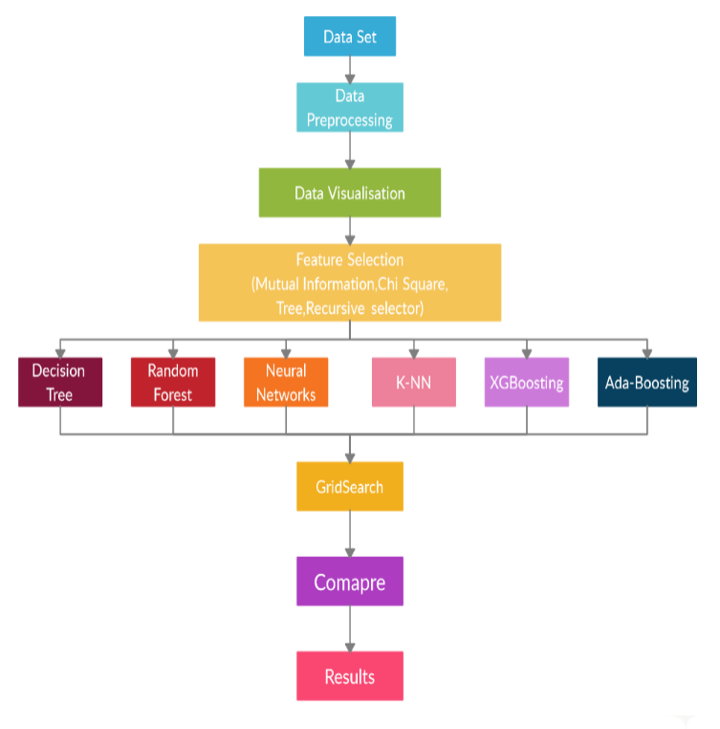
Methodology

Slide 4
Module Description
Dataset is an Employee data set which we obtained from the Kaggle website.
Data Pre-processing :- Here we convert the categorical and ordinal data to numerical Data.
Feature Selection:- By using Multilinear model we remove some of the collinearity features(Similar or derived) from the data set. We also used PCA to make all important variables to form into 3 variables.
Decision Tree, Random forest, Neural Networks , XGB(Xtreme Gradient Boosting), KNN, Ada Boosting :- these are machine learning models.
Grid Search : We use Grid search to find the best parameters for each model.
Compare : Here we will compare all the AUCROC Curves and pick the best model.

Slide 5
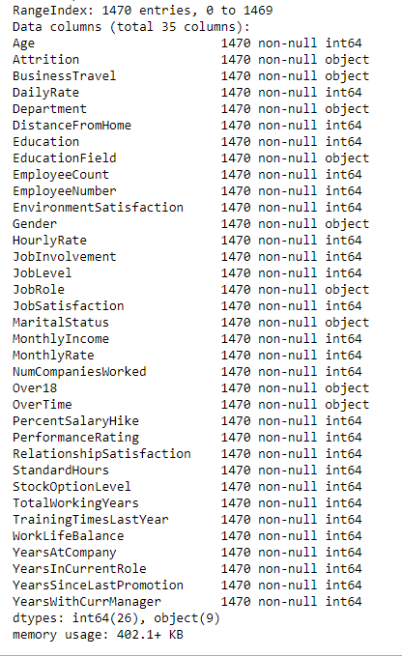
Data set
The HR-data set from Kaggle contains 35 features in which 34 are independent features and the remaining one is a dependent feature which is our output. Figure lists all the features of the data set along with the possible values each feature can take, its data type and also an indication if there are any null values in the data The features are almost self-explanatory from their names themselves.

Slide 6
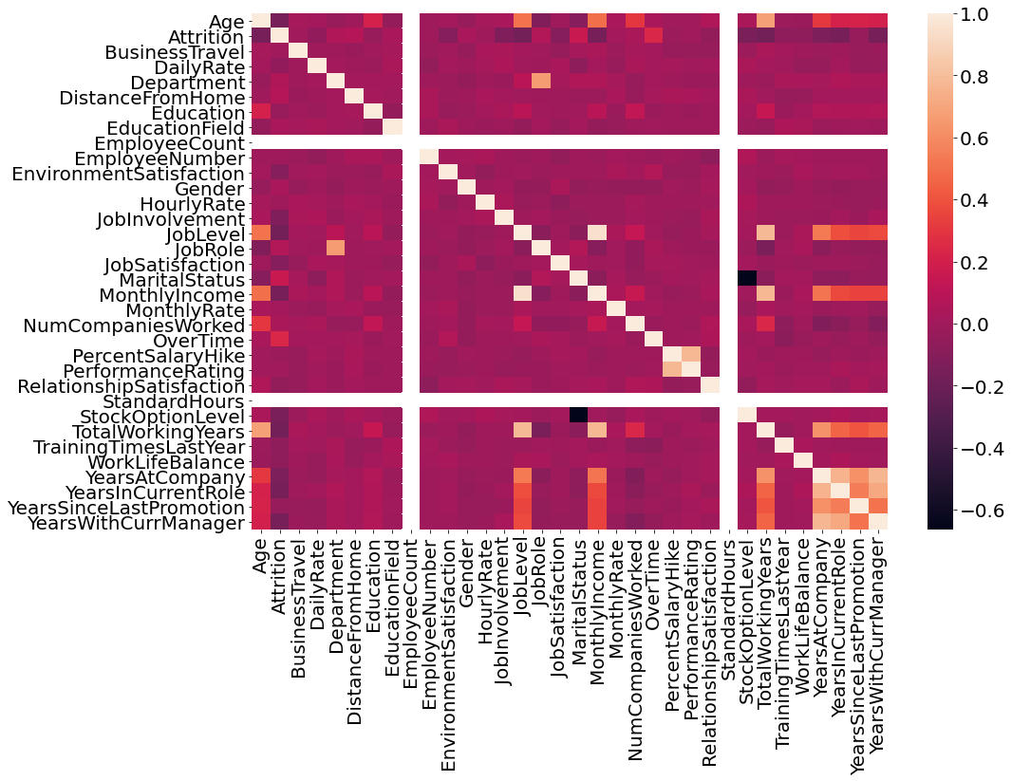
Correlation Graph
Employee count and Standard Hours are perfect positive correlative so we can remove it
monthly income is higly correlated with job level and total working years
total working years with age
Department with job role
Years at company, Years in current role, Years since last promotion, Years with current manager are mostly similar
marital status is inversly correlated to stock option level

Slide 7
Feature Selection
After applying the Mutual Information method, Recursive Method, Tree selector method and Chi-square method to all features concerning attrition, we consider only the top 15 features from each method and we will join them into a set. As a result, we will get 23 features listed as follows. Along with these 23 features, we add our 8 PCA features and hence totally we will get 31 features.
'BusinessTravel_Non-Travel, 'BusinessTravel_Travel_Frequently’,‘Department_Sales’ 'EducationField_Human Resources' 'EducationField_Life Sciences' 'EducationField_Technical Degree', 'EnvironmentSatisfaction', 'JobInvolvement', 'JobRole_Healthcare Representative','JobRole_Human Resources', 'JobRole_Laboratory Technician', 'JobRole_Manager’, 'JobRole_Manufacturing Director', 'JobRole_Research Director’, 'JobRole_Sales Representative','JobSatisfaction’, 'MaritalStatus_Divorced', 'MaritalStatus_Single', 'OverTime_No’, 'OverTime_Yes', 'RelationshipSatisfaction',' StockOptionLevel’ 'WorkLifeBalance'.

Slide 8
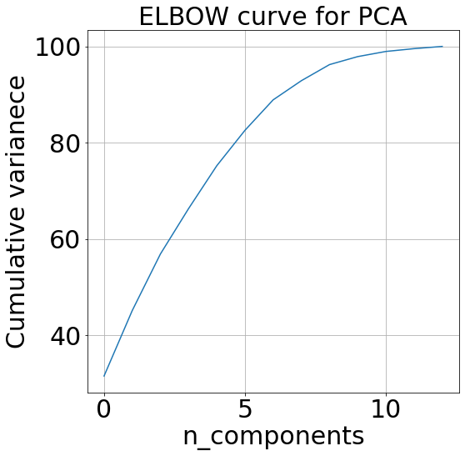
PCA
From using Chi Square , Recursive Selector and Tree Selector we took top 27 features which are common among these three . Now remaining 27 features are present now we will convert these 27 features into 8 Features by using Elbow curve and then we will add these 8 features to 23 features and we will remove these 27 features from data.

Slide 9
Algorithms Used
Decision Tree
Random forest
Neural Networks
XGB(Xtreme Gradient Boosting)
KNN( K- Nearest Neighbourhood)
Ada Boosting

Slide 10

Decision Tree
Decision trees are useful when data possess nonlinear patterns present in them. It is represented as a flow chart in which internal nodes represent the test on a particular feature and the branches represent the output of the test and the child node represents the class in which the input/item is classified.
We consider Entropy as the splitting constraint. The decision tree which we get for the employee attrition prediction is shown in Fig. 6. The formula for the Entropy is given by the following equation.
Entropy(S) = ∑-p_{i}*log₂(p_{i})

Slide 11
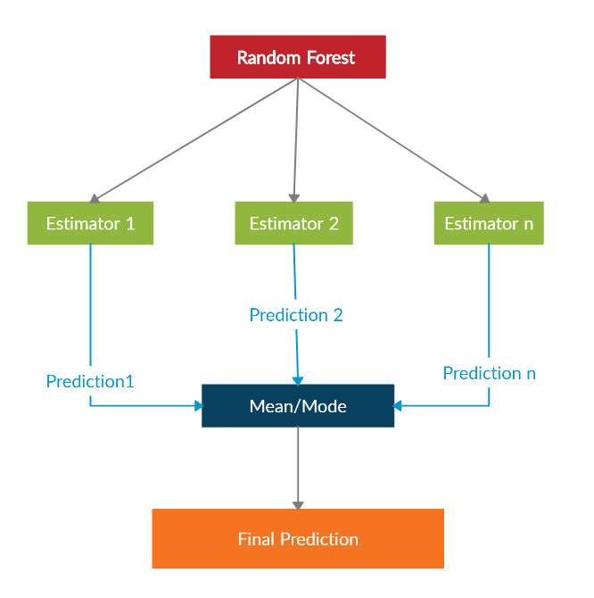
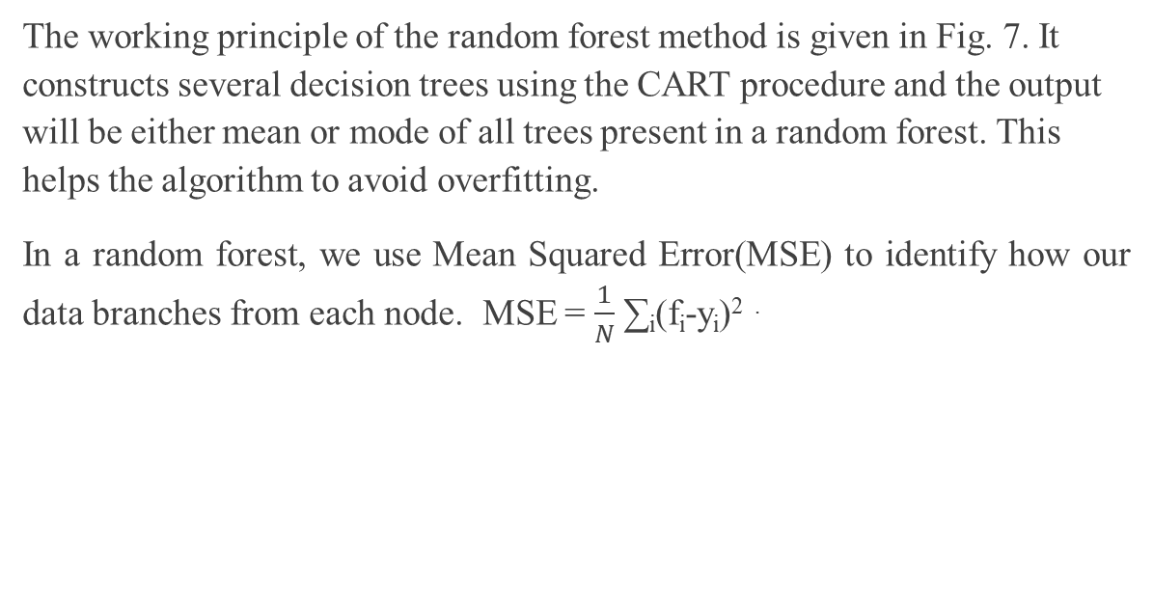
Random Forest
The working principle of the random forest method is given in Fig. 7. It constructs several decision trees using the CART procedure and the output will be either mean or mode of all trees present in a random forest. This helps the algorithm to avoid overfitting.
In a random forest, we use Mean Squared Error(MSE) to identify how our data branches from each node. MSE = $\frac{1}{N}$ ∑_{i}(f_{i}-y_{i})^{2 .}

Slide 12

Neural Networks
Neural networks are mostly used for image classifications and computer vision to learn patterns on the unstructured data. As we know that neural networks work best for unstructured data, it is capable of taking out difficult patterns from data. Since our data is biased, we selected neural networks to find how best this works for our problem.
The input for each neuron can be given by z=w^{T}x+b where W^{T} is a weight vector and b is the bias. The output of the neuron is y = g(z) in which the function g is called a sigmoid function. The loss function can be given by

Slide 13
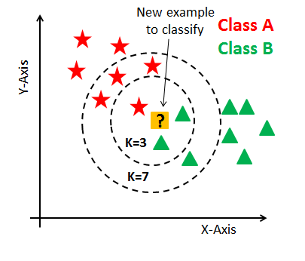
K Nearest Neighborhood
KNN algorithm works based on geometrical principles. This algorithm plots all the points in the multi-dimensional plain and then indexes them according to their class. When a new point enters, it gets plotted on plain and then takes the mode of the k nearest points as the class of it. It works best for classification models when there exists a geometrical relationship present among the features of the data.

Slide 14
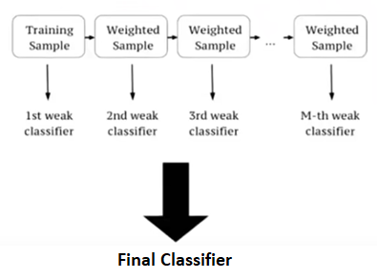
eXtreme Gradient Boosting
XGB algorithm is an advanced version of Random forest. In the random forest, each subtree is independent but in the XGB model the trees are interlinked and error in the current tree is adjusted through constructing consecutive trees by reducing errors. Every tree has some weight in the final prediction of the model according to its error rate.
The main formulae’s we use in the XGB is similarity score = ƩƟ / (ȅ +λ )
where λ is used for regularization which varies between 0-1 and Ɵ = error residual= difference between the predicted and expected values ȅ = error samples

Slide 15
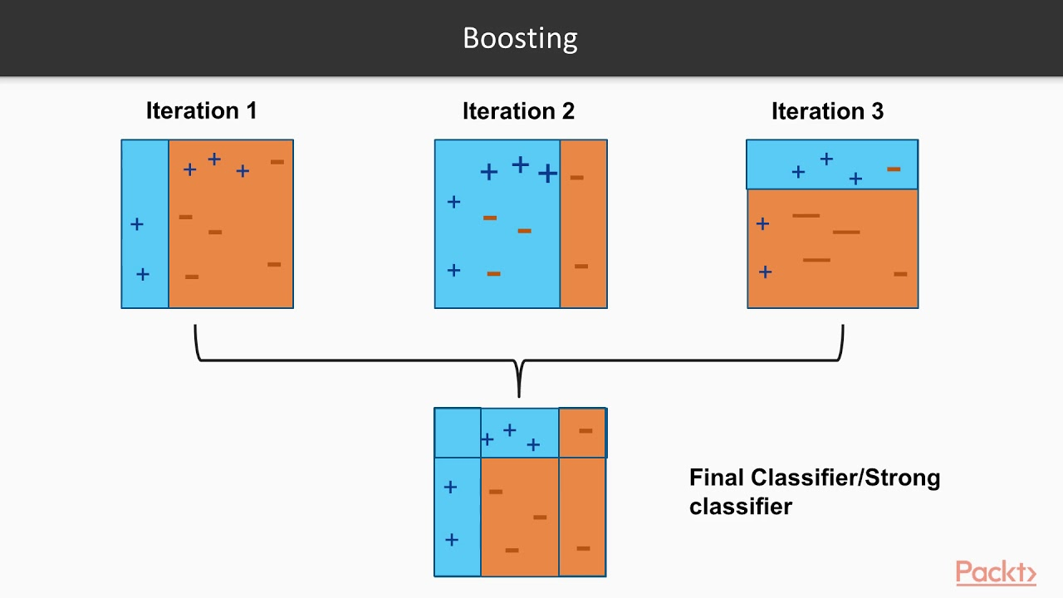
Ada Boosting
This model is constructed by ensembling weak learners. Here linear regression is used as the weak learner for regression models, stumps as the classification models. Stump is a tree with one parent node and two leaf nodes and works similar to the trees in XGB. Each consecutive stump is created to overcome the errors of previously constructed stumps. Adaptive Boosting algorithm performs better on unbalanced data.

Slide 16
Implementation:(Regularization)
In this experiment we find the best parameters using grid search for each classifier, so we also need to find the parameters which should be balanced means should not overfit for data.
The parameters are to be in such a way that the should avoid overfitting and underfitting.
It is possible by doing the operations of this model to this Dataset separately and finding the optimum parameters. After ward we will combine all parameters into a final ensemble model.
Since the main aim of any application is to reduce the Time complexity and Space complexity we go through regularization.

Slide 17
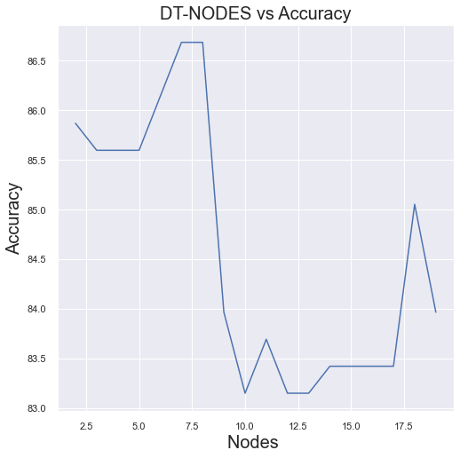
Decision Tree Regularization
From the graph we observe that the model is Regularized at Nodes = 5 with 86% accuracy. Here nodes means the maximum number of child leaf nodes in each branch at terminating end.

Slide 18
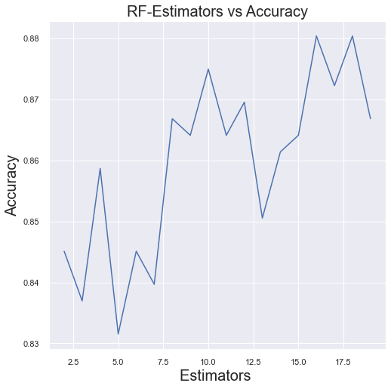
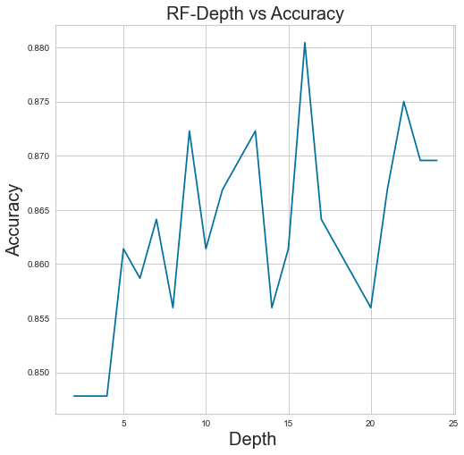
Random forest Regularization
From the both graphs we observe that the model will be Regularized at
Tree_Depth = 5 with 86% accuracy and No.of Estimators = 10 with 87% accuracy.
So we use this values in final model.

Slide 19
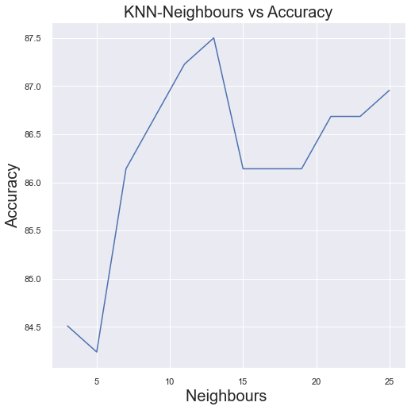
KNN
From the graph we observe that the model is Regularized at Neighbours = 15 with 86% accuracy.

Slide 20
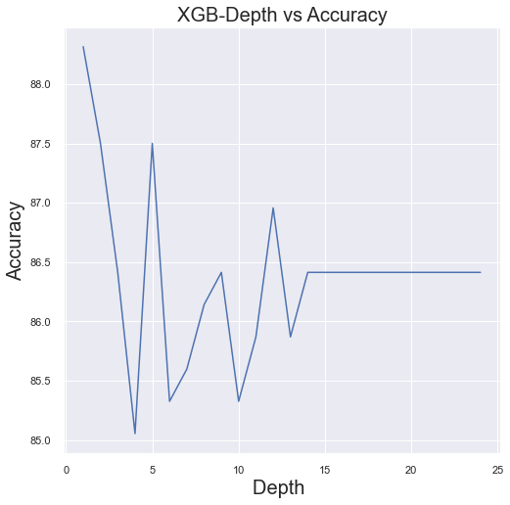
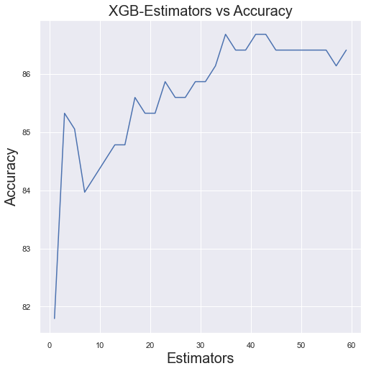
XG Boosting Regularization
From the graphs we observed that the graph with depth = 15 is regularised very well .
So we can take the 40 estimators with ~ 87% accuracy as the regularized value .

Slide 21
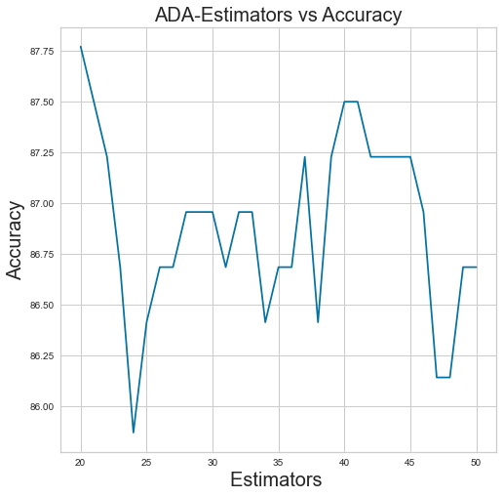
Ada Boosting Regularization
From the graph we observe that the model is Regularized at Estimator = 30 with 87% accuracy. Here Estimators means the maximum number of child Trees Ensembled.

Slide 22
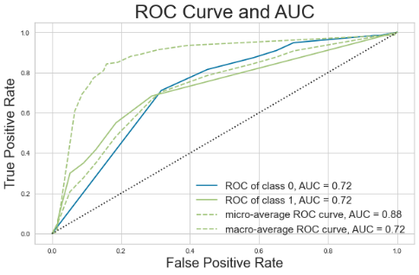
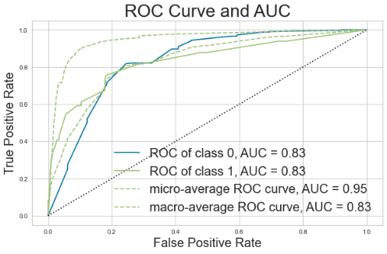
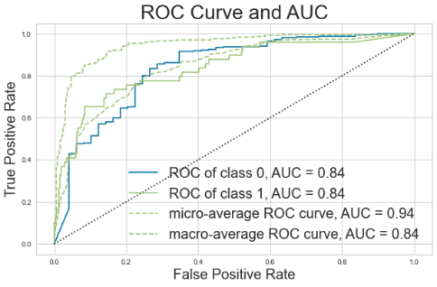
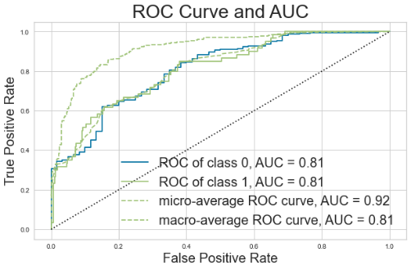
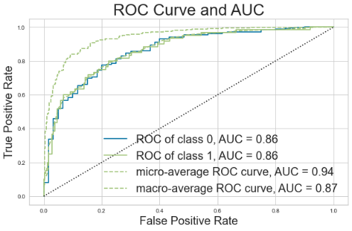
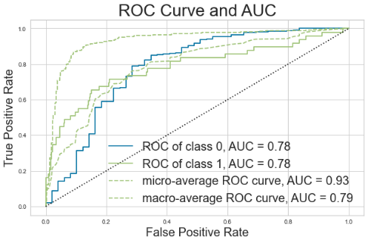
AUCROC Curves for all models.
Decision Tree Random Forest KNN
Neural Networks XG Boosting Ada Boosting

Slide 23
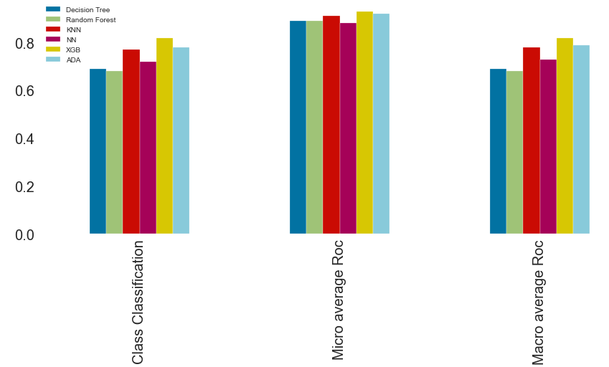
AUCROC Comparison
From the following comparison graph we also observed that the XGB model which is yellow colour is top on three metrics among all models . Here also XGB Outperformed all the other models.

Slide 24
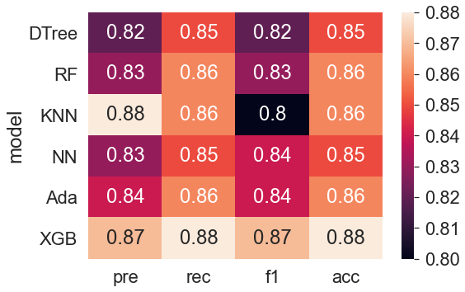
Results
The Results of all Models are drawn in heatmap which is as follows.
From graph we can observe that XGB outperformed all
the other models in all metrics.

Slide 25
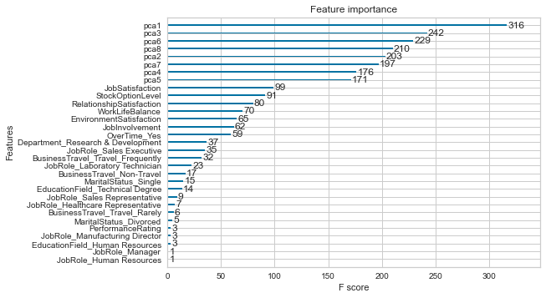
Feature Importance
From XGB it figured out that the unwanted features which turned into PCA are giving more information about Attrition.

Slide 26
References
David J. Storey,” Understanding the Small Business Sector: Reflections and Confessions”.
Jantan, Hamidah Jantan et al. “Human Talent Prediction in HRM using C4.5 Classification Algorithm “ (IJCSE) International Journal on Computer Science and Engineering Vol. 02, No. 08, 2010, 2526-2534.
Nagadevara, V., Srinivasan, V. & Valk, R. (2008). Establishing a Link Between Employee Turnover and Withdrawal Behaviours: Application of Data Mining Techniques, Research and Practice in Human Resource Management, 16(2), 81-99.
Pankaj Ajit, “Prediction of Employee Turnover in Organizations using Machine Learning Algorithms A case for Extreme Gradient Boosting” International Journal of Advanced Research in Artificial Intelligence, Vol. 5, No. 9, 2016.
Xiang Gao, Junhao Wen, and Cheng Zhang:” An Improved Random Forest Algorithm for Predicting Employee Turnover” Volume 2019, Article ID 4140707, https://doi.org/10.1155/2019/4140707.

Slide 27


Slide 28


